Slide 1
Wearable EMS Device
for Patients
with Parkinson’s Disease
Team 10
Cainwyn Leung | Claire Kim
Radhey Patel
Notes:
Claire
Hello, This is Team 10 and today we're going to present our wearable EMS Device for patients with Parkinson's Disease.
Time: 7secs

Slide 2
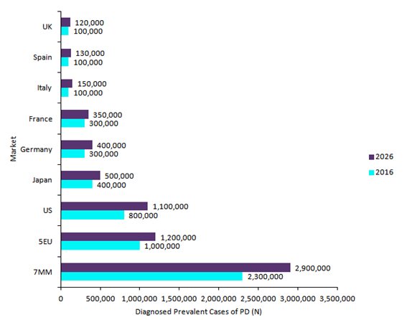
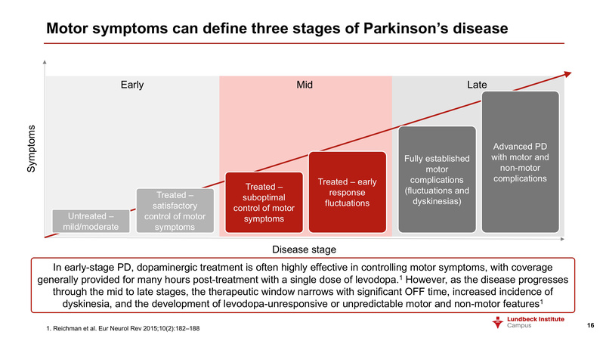
Background
Parkinson's disease (PD)
A Brain disorder; Occurs when neurons that control movement become impaired
=> Production of less dopamine
Symptoms begin gradually and get worse over time
Involuntary tremor majorly in hands, arms, and legs
Muscle stiffness due to Muscle Fatigue
Bradykinesia (slowness of movement)
About 95-96% of PD patients are diagnosed around the age of 60
The second most common degenerative neurological disorder after Alzheimer’s disease
After at least 10 years of PD, patients have an increased disease burden & a greater impairment in quality of life
Unmet need: Wear-off effect of medication through mid to late stages of PD
Current treatments do not perfectly cure PD symptoms
Notes:
Claire
Parkinson's disease is a progressive neurodegenerative brain disorder that begin gradually when neurons become impaired and get worse over time. PD largely consists of motor symptoms such as involuntary tremor in hands and arms, muscle stiffness, and the slowness of movement called, Bradykinesia.
With more than 10 million people living with PD worldwide, it is the second most common neurological disorder after Alzheimer's, and about 95% of patients are diagnosed pretty late in their age, around 60. So after at least 10 years of PD, patients suffer from an increased disease burden and a greater impairment in quality of life. Especially, their biggest unmet need is the wear-off effect of medication through mid to late stages of motor symptoms.
Time: 49 secs

Slide 3
Existing Solutions
PhysioTherapy
Speech Therapy +
Occupational Therapy
Aerobic Exercise under Observation
Electric Muscle Stimulation using a medium-frequency band
Medications
Duopa : Levodopa + Carbidopa
Dopamine Agonists
COMT Inhibitors
MAO-B Inhibitors
Surgery
Stereotactic Surgery
Deep Brain Stimulation
Thalotomy
Pallidotomy
Notes:
Selina / (R)
Surgery: Placing a feedback control neurostimulator to modulate electrical impulses in the Basal Ganglia in the brain
levodopa-carbidopa intestinal gel infusion
subcutaneous infusion of the dopamine agonist apomorphine
Different treatments for PD solutions can be understood on a severity timeline. During the first stages of PD, patients could practice physiotherapy such as speech therapy and aerobic exercise. FES and EMS are still in early experimental stages, which we would like to implement in our device. These treatments may ease motor symptoms. Though they could only be effective with in the first 5 years of prognosis. Then medications intake of levodopa along with carbidopa, dopamine agonists, comt inhibitors, mao-b inhibitors could be alleviate symptoms of parkinsonism as well. These medications comes with side effect and long term intake may increase the patient’s risk of infections and lead to symptoms like loss of appetite and hair loss. Surgery would be used in later stages of PD, such as deep brain stimulation, thalamotomy and pallidotomy. Even though procedure is safe, these invasive surgeries may cause tissue or nerve damage.
1min 10 s

Slide 4
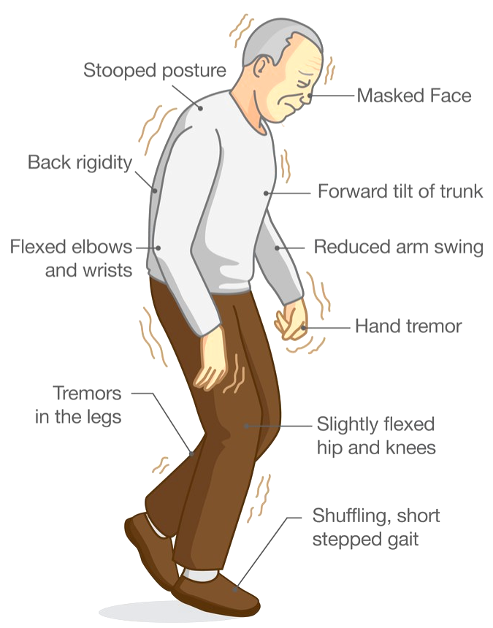
Stakeholders
Physical Therapist at Senior Care Center
Alleviating / Preventing major motor symptoms of PD is significant to reduce the chance of developing complications
Importance of muscle stimulation technique
Help patients’ muscles keep moving => preventing further progression of motor symptoms
Caregiver of PD patient
Need something that can be easily & regularly utilized by patients w/o help of any professionalists
Elderly patients => Difficulty in visiting the hospital on a regular basis
Need something that do not directly impact the internal system of body
Medication side effects & misuse
Physician & Scientific Operations Technologist for Neurodegenerative Disorders
The average medication cycle mandates aerobic exercises and physiotherapy throughout the progression
Stimulation of muscles
Dampen the major motor symptoms for the early to medium stages of PD
↑ in lifespan (10-15 years) w/o losing their mental and physical faculties
Notes:
Claire
As our first main stakeholder, the caregiver of PD patient shared his concern of the elderly patients experiencing difficulty to visit the hospital on a regular basis, even with their support and care. So he was hoping to see devices that can be utilized by patients easily & regularly at home, w/o help of any specialists, and also the need of treatments that do not directly impact their internal system, mentioning the side effects and misuse of medication that his patient had to undergo.
In terms of less-invasive treatment options, the physical therapist described the importance of using muscle stimulation technique to help patients’ muscles keep moving and prevent further progression of motor symptoms that could generate some serious complications.
Finally, scientific operations technologist also emphasized how the average medication cycle mandates physiotherapy throughout the progression, stimulating muscles and dampening the major motor symptoms for the early to medium stages of PD and its benefit of increasing patients' lifespan w/o losing their mental and physical faculties.
Time: 1 min and 10 secs

Slide 5
Needs Statement
A device to aid in delaying onset of Parkinsonism in patients diagnosed with Parkinson's Disease within the first 10 years of the prognosis
Problem: Recurring tremors, muscle stiffening, and Bradykinesia
Population: Patients diagnosed with Parkinson's Disease within the first 10 years of their disease development
Outcome: Reducing tremors, muscle stiffening, and Bradykinesia as well as improving patients' quality of life
Notes:
Selina
Our need statement is: a device to aid in delaying onset of Parkinsonism in patients diagnosed with parkinson’s disease within the first 10 years of the prognosis. Current problems include recurring tremors, muscle stiffening and Bradykinesia. We are specially targeting patients with in the first 10 years of their disease development. Our device’s main goal is to reduce motor symptoms such as tremors and muscle stiffening.
Time: 20-30s

Slide 6
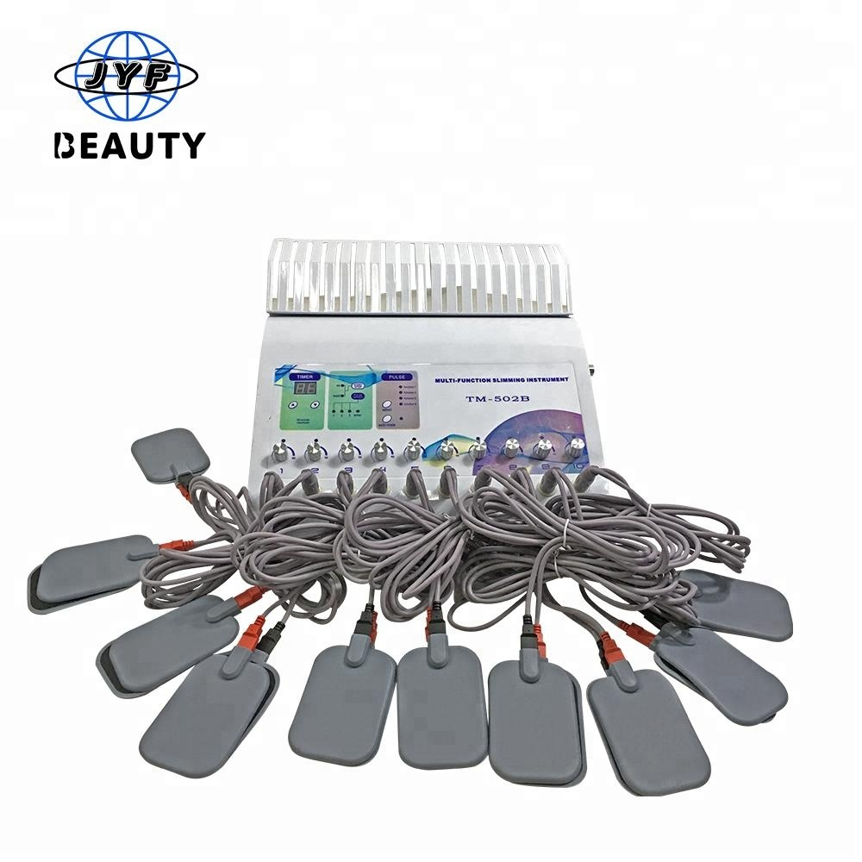
Problem Solution
Electrical Muscle Stimulation (EMS)
Excitation of muscle contraction using electric impulses through electrode pads on the skin near to the muscles being stimulated
Mimic the action potential that comes from the central nervous system (CNS), causing muscle contraction
Used as a rehabilitation and preventive tool for patients (or sometimes muscle training for the athletes)
Modulation of peripheral reflex mechanism by EMS
Improving resting tremor & muscle rigidity temporarily
May ultimately reduce the severity of Bradykinesia
Current EMS (FDA-Certified): over-the counter devices (OTC) & prescription devices
Our Plan
Original small electrode pads (4 cm X 4 cm) => Original + redesigned electrode pads (longer & wider)
Complex system with a large machine + many lead plug wires => Compact & portable system
Accessible only in hospital => Accessible at home
Wearable
Rechargeable & Reusable
Notes:
Claire
Based on this information, we've decided to utilize electrical muscle stimulation as our solution. EMS elicits muscle contraction by triggering electric impulses through electrode pads on the skin and this is currently used as a rehabilitation and preventative tool for patients. As it largely mimics the action potential that cause muscle contraction for movements, we thought the EMS has its potential to modulate peripheral reflex mechanism for patients with PD and may improve their resting tremor & muscle rigidity temporarily, ultimately reducing the severity of Bradykinesia.
For more effectiveness, we planned to redesign the electrode pads that are originally small and short to longer and wider ones, stimulating larger regions of muscles. They were then facilitated to make a portable, wearable, rechargeable, and reusable device for domestic use, resolving the limitations of current EMS.
Time: 1 minute

Slide 7
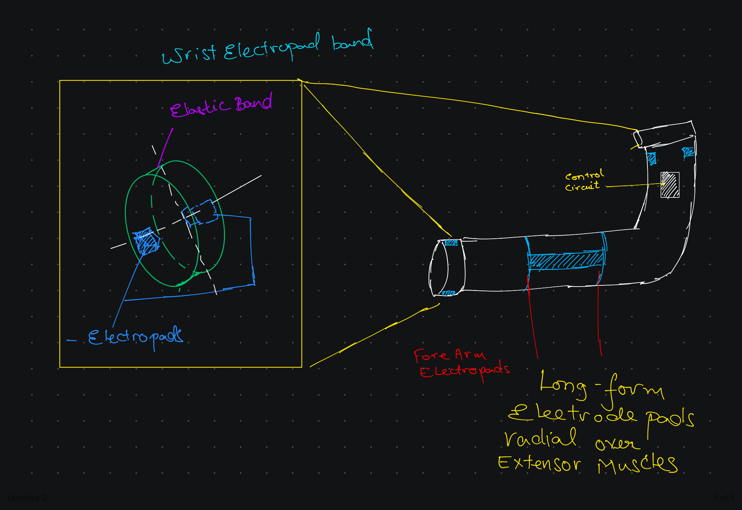
Industrial Design Specification
Notes:
Radhey
The place of electrode pads and why we think this is significant As Claire mentioned, the 2 key focus for our design were to provide a portable patient-friendly model to integrate EMS into their daily physical regiment and provide easement in independently putting on such a device. Through multiple iterations of design and stakeholder interview we came to the conclusion the easiest way for a PD patient is to put on a sleeve- Our EMS sleeve has 3 pairs of opposing electrodes place along the patient’s wrist, forearm and around the bicep and tricep column to optimize for surfaces susceptible to tremor and its reduction.

Slide 8
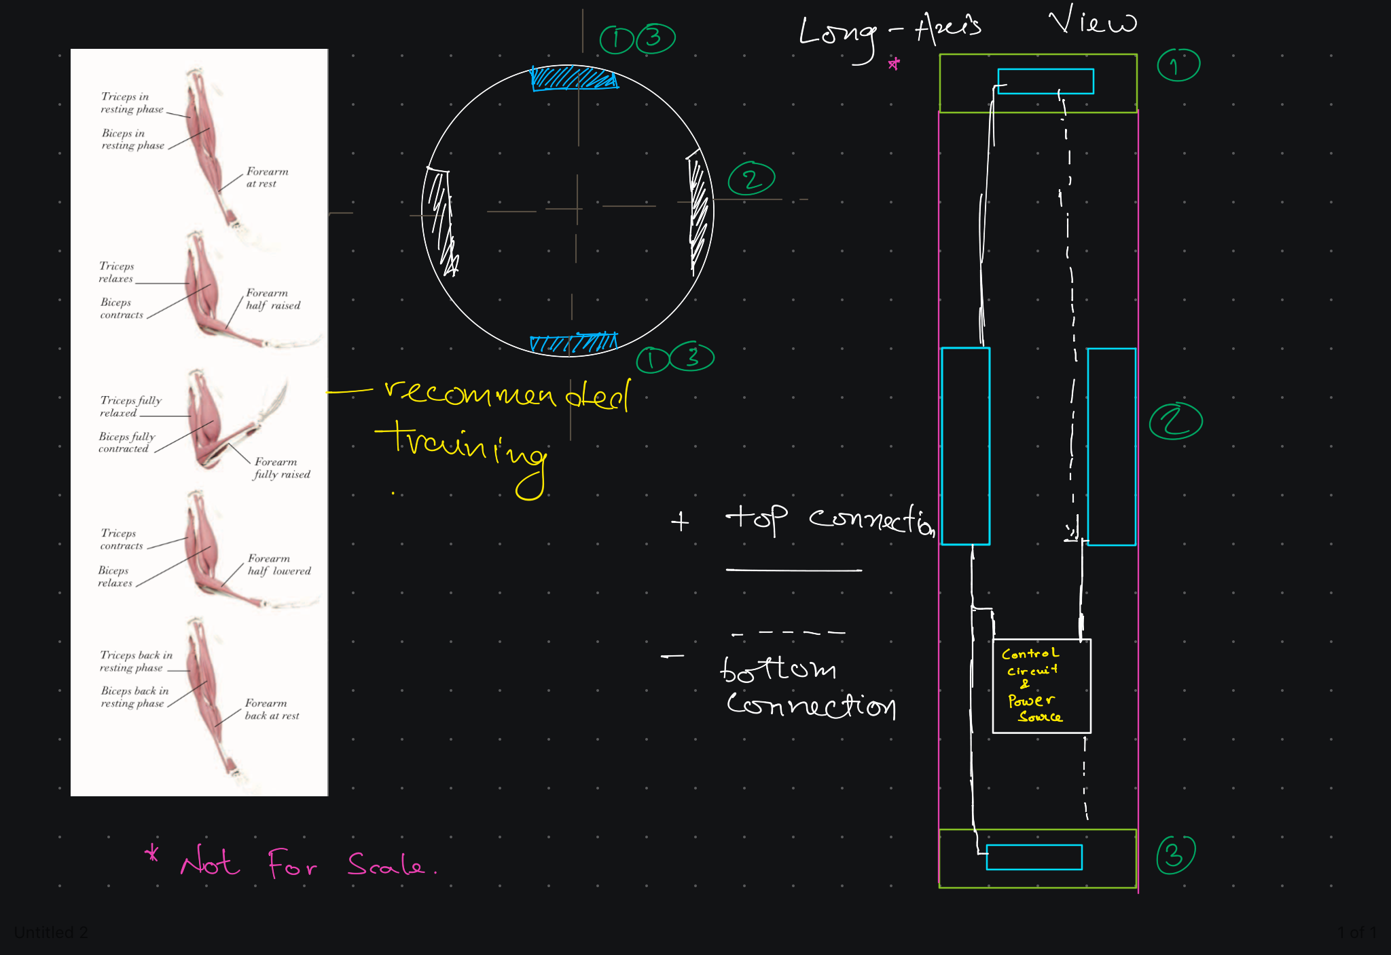
Industrial Design Specification
Notes:
Radhey As viewed in the diagram here, the sleeve would focus on the three zones to strengthen muscles through/during exercise sessions Aerobic or otherwise.

Slide 9
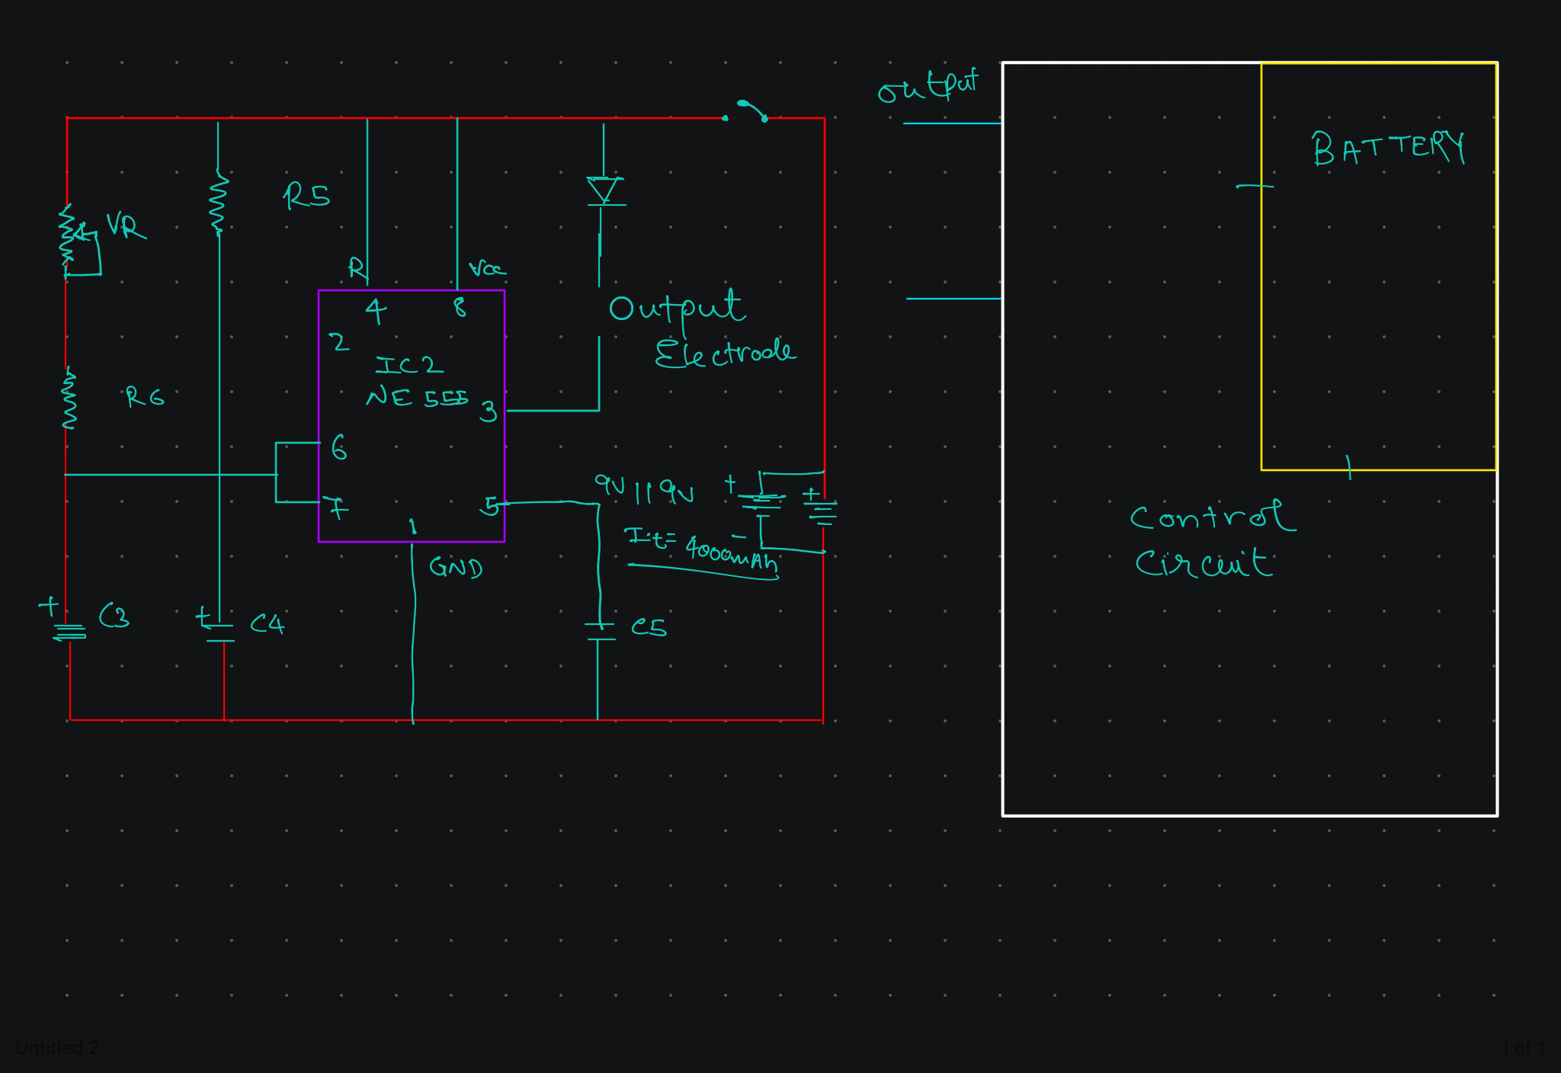
Industrial Design Specification
Notes:
Radhey
These electrical pulses range close from 10-50 mA with the median being focused around 20mA at a frequency of 1 hz/5hz/10/30hz with a square wave form, a unipolar mode or a sine wave form depending on the setting.

Slide 10
Product Design Specification
Parameter | Unit | Datum | Target Range
Material Components | 3 | - | -
Manufacturing Cost | USD ($) | The project range can be lowered depending on choice of manufacturing location | 100
Weight of the Device | grams | N/A | ~ 680
Electrical Output | mA | Battery capacity < 2000mAh | 20 mA
Pulse Frequency | Hz | Pulse Auto Cycles for 30 minutes | 1, 5, 10, 30
Battery Voltage | V | 2x Rechargeable | 9V
Notes:
Radhey

Slide 11
Material Selection
The External Sleeve + Modulator Holder:
Polyester: 70%
Spandex: 20%
Nylon: 10%
Silicone Gel Pads with Electrodes
Notes:
Radhey

Slide 12
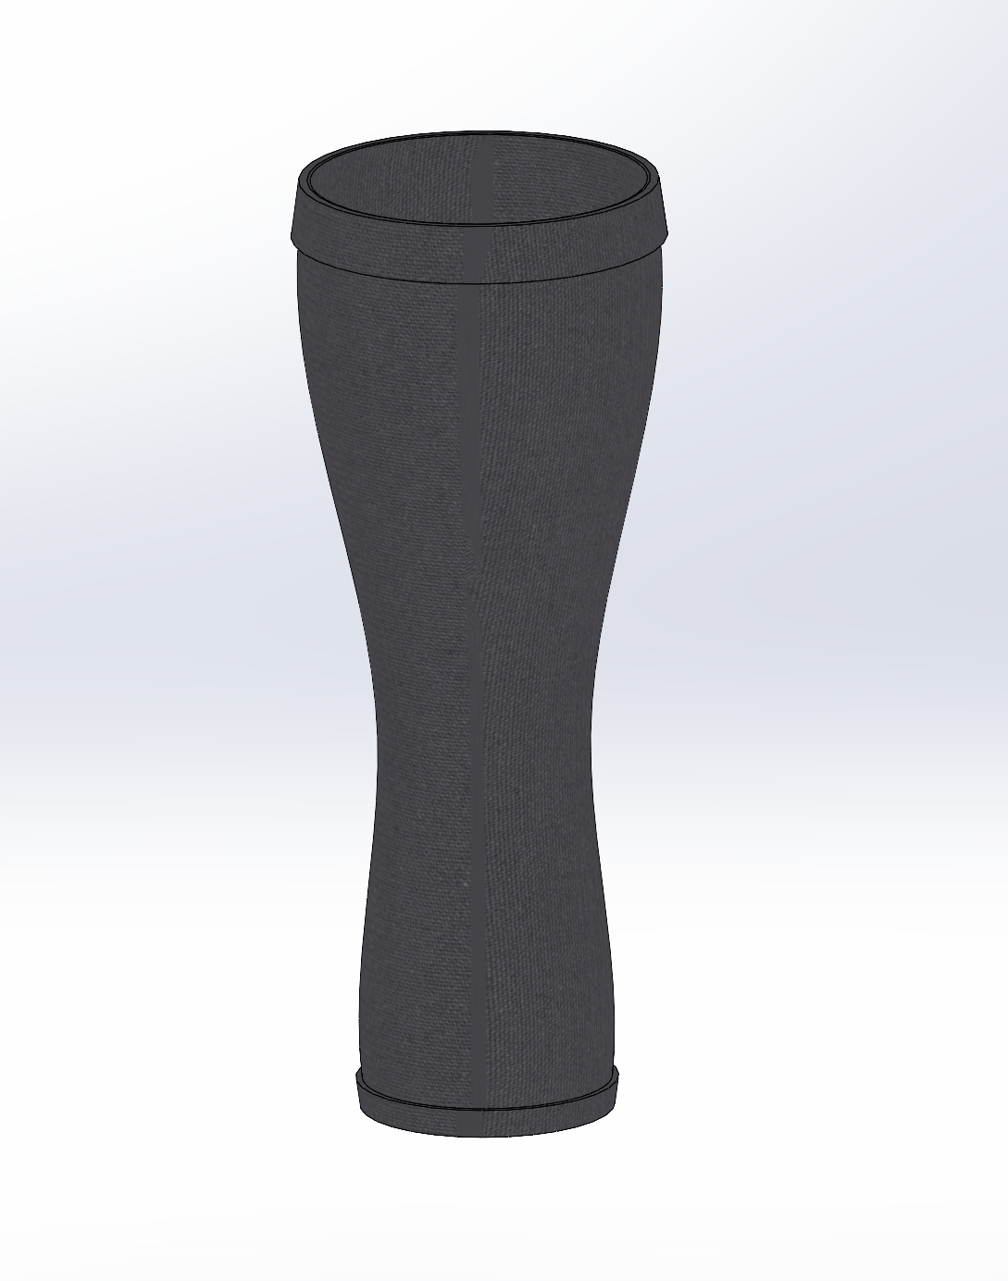
Looks-like Prototype
Elastic Fabric Sleeve
Notes:
Cainwyn

Slide 13
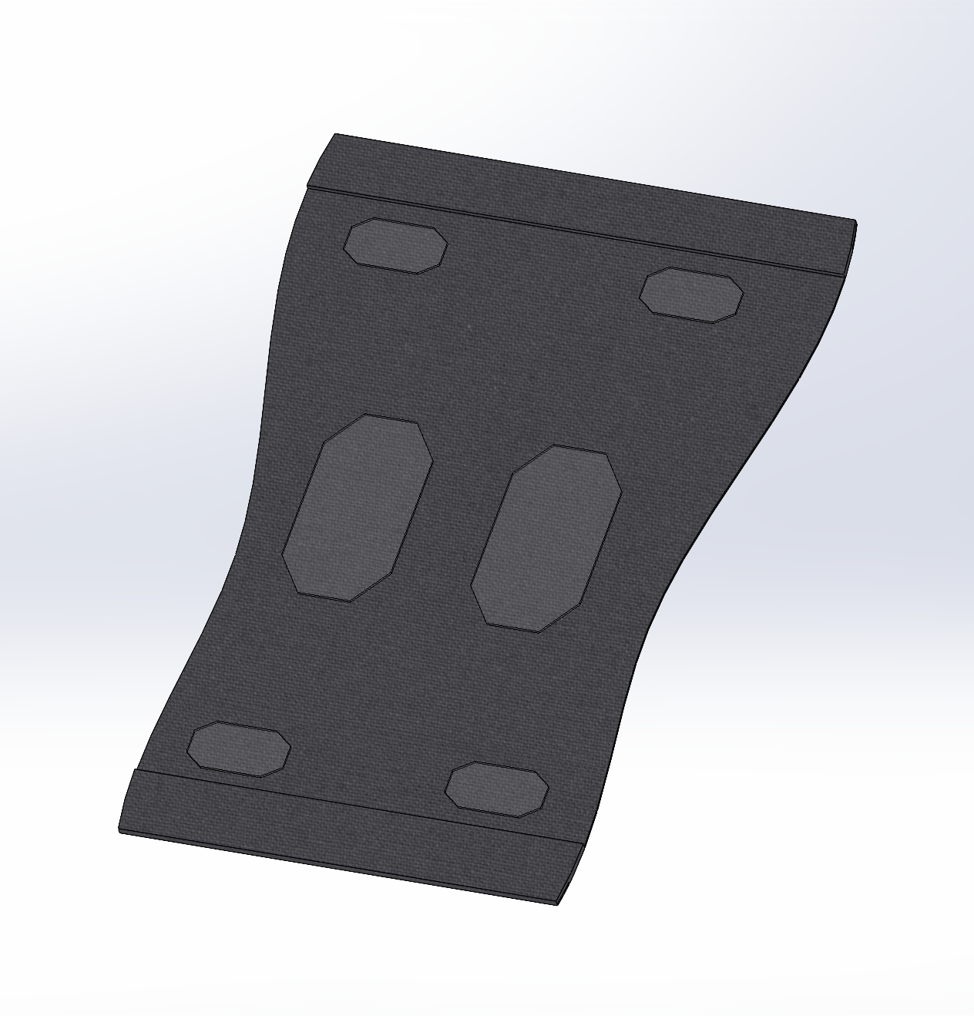
Looks-like Prototype
Interior of Elastic Fabric Sleeve
-electrode pads
-elastic bands on top and bottom
Notes:
Cainwyn

Slide 14
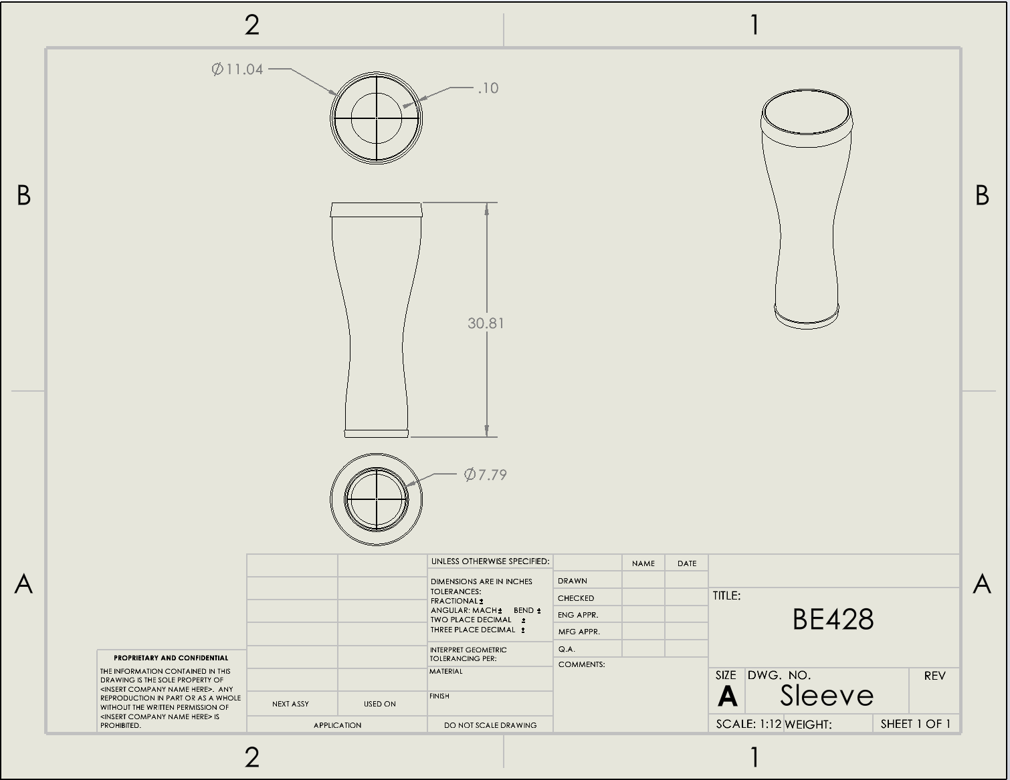
Looks-like Prototype
Engineering Drawing of Elastic Fabric Sleeve
-dimensions
-ready for manufacturing
Notes:
Cainwyn

Slide 15
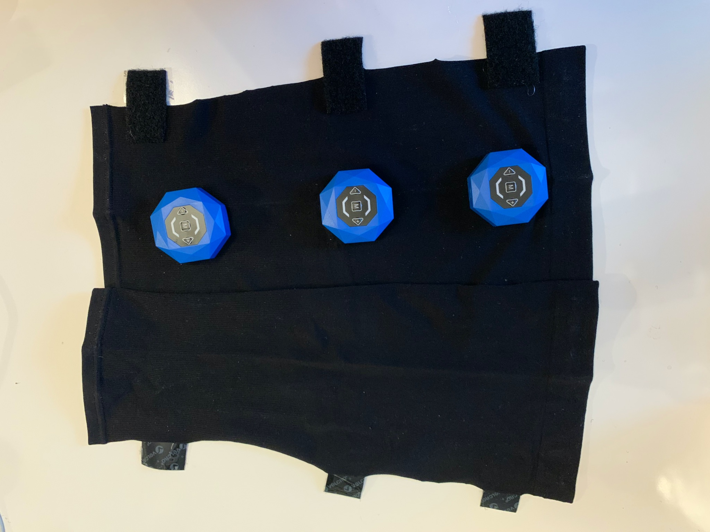
Works-like Prototype
Working Prototype of EMS Sleeve
Notes:
Cainwyn

Slide 16
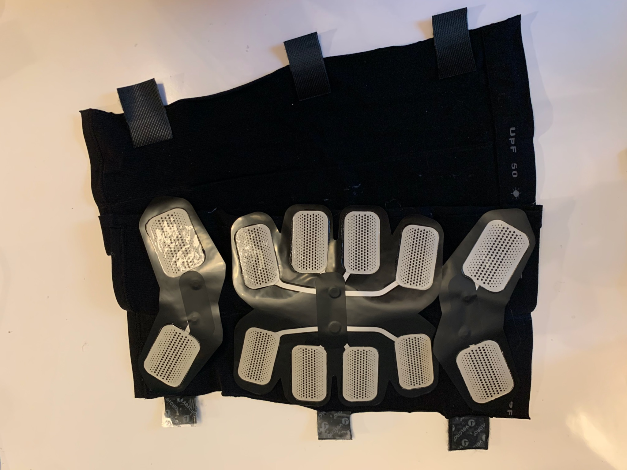
Works-like Prototype
Working Prototype of EMS Sleeve
Notes:
Cainwyn

Slide 17

Works-like Prototype
Working Prototype of EMS Sleeve
Video
Notes:
Cainwyn
non adhesive electrode pads for slip on sleeve
easier to turn on with 1 button for all electrode pads

Slide 18
Failure Analysis
323
70%
Surgery: Deep Brain Stimulation
Possible failure mechanisms & limitations
Electrode pads malfunctioning
Unexpected mechanical or electrical defects
Limited device users to patients only within the early-miterm stages of PD
Elderly patients with serious chronic diseases may not be allowed to use our product
ex) pacemaker
Future tests/Killer Experiments
323 clinical trials for Patients diagnosed with PD
Investigating the best optimizations for padding positions through trials
De-risk
Timely interval pad switch
Remaining routine practice with device during the first stages of patient’s prognosis
Notes:
Selina (Possible limitations, De-risk, Future improvement) & Radhey (Future tests/ Killer Experiments)
70 % of population : attenuation in ⅓ of their tremor
30 % of population: fails to attenuate in ⅓ of their tremor
p value= 0.05
estimated population size: 323
Every device may have limitations and failure mechanisms. Our device may experience electrode pad malfunctioning, unexpected mechanical defects. To de-risk this, we may ask patients to do a pad switch routinely. Some limitations to our device is that we only target patients within the early to midterm stages of PD, and elderly patients with serious chronic diseases should not be allowed to use these products, such as patients with pacemakers. Some of the future improvements we wish to expand is to completely eliminate motor symptoms and to provide ems even for neuronal improvements.
40 s

Slide 19
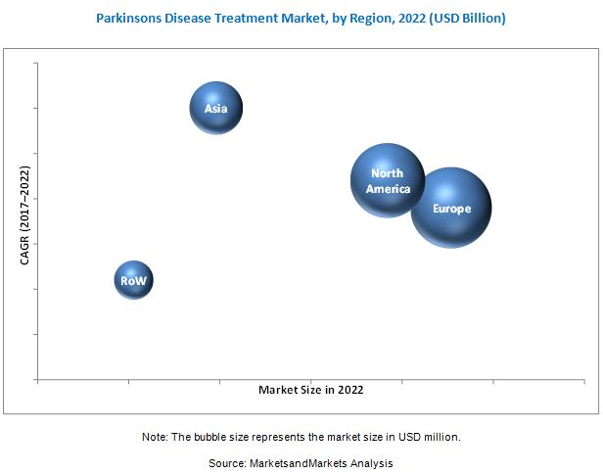
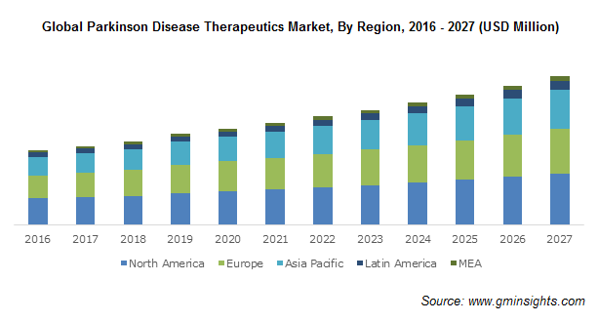
Conclusions
FDA regulatory pathway: Class II
ex) Stimulator, Muscle, Powered, For Muscle Conditioning (Product code: NGX)
Need of special controls
Impact to the market
Offered at much lower cost compared to other minor device-aided PD treatments
Easy of access (with just a prescription) & Easy utilization (without professional knowledge) for rising aging population
Portable & Reusable
Overall, highly cost effective
Challenges in the market
Rising generic drug & device manufacturers
Availability of alternative treatments
Market dominated by Europe & United States
Limited opportunities
Notes:
Claire
For FDA product classification, we categorized our product as Class 2, largely because we found some existing products that use EMS, assuring its safety and effectiveness.
The impact of our device would be overall highly cost-effective when we bring into the market as it can be offered at much lower cost than other minor device-aided PD treatments with its merits of easy accessibility and application methods for rising aging population.
However, because of the increasing generic drug and device manufacturers and the availability of alternative treatments with the market being concentrated in few countries, we expect there will be some challenges and limited opportunities for market entry.
Time: 47 secs

Slide 20
References
Jitkritsadakul, Onanong et al. “Exploring the effect of electrical muscle stimulation as a novel treatment of intractable tremor in Parkinson's disease.” Journal of the neurological sciences vol. 358,1-2 (2015): 146-52. doi:10.1016/j.jns.2015.08.1527
Jitkritsadakul, Onanong et al. “Tremor's glove-an innovative electrical muscle stimulation therapy for intractable tremor in Parkinson's disease: A randomized sham-controlled trial.” Journal of the neurological sciences vol. 381 (2017): 331-340. doi:10.1016/j.jns.2017.08.3246
Park, Ji-Su et al. “Effects of neuromuscular electrical stimulation in patients with Parkinson's disease and dysphagia: A randomized, single-blind, placebo-controlled trial.” NeuroRehabilitation vol. 42,4 (2018): 457-463. doi:10.3233/NRE-172306
Park, J-S et al. “Effects of neuromuscular electrical stimulation combined with effortful swallowing on post-stroke oropharyngeal dysphagia: a randomised controlled trial.” Journal of oral rehabilitation vol. 43,6 (2016): 426-34. doi:10.1111/joor.12390
Popa, Livia, and Paul Taylor. “Functional electrical stimulation may reduce bradykinesia in Parkinson's disease: A feasibility study.” Journal of rehabilitation and assistive technologies engineering vol. 2 2055668315607836. 26 Oct. 2015, doi:10.1177/2055668315607836
https://www.accessdata.fda.gov/scripts/cdrh/cfdocs/cfpcd/classification.cfm?id=5380

